Slide 1

Apache Spark

Slide 2
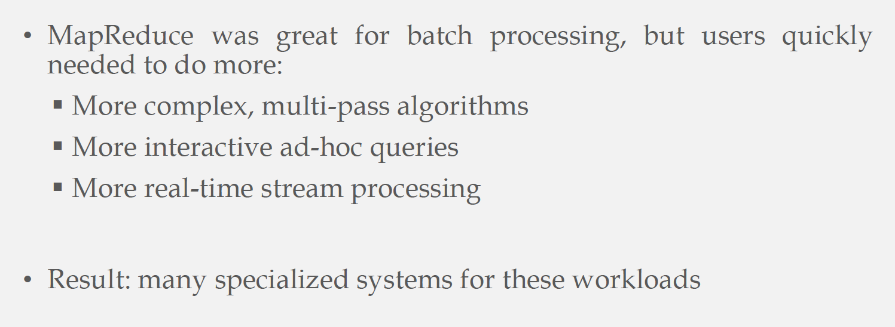

Why Need Another Infrastructure
Hadoop is widely used by many applications, each has some diverse requirements and needs

Slide 3
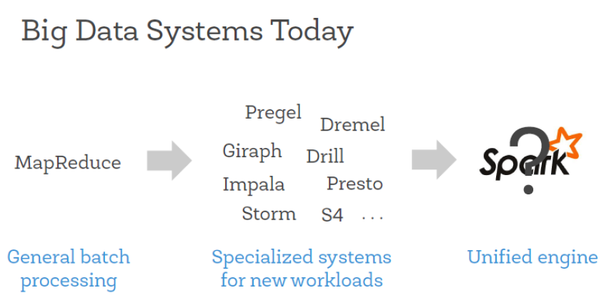
Why Need Another Infrastructure: Specialized Systems

Slide 4
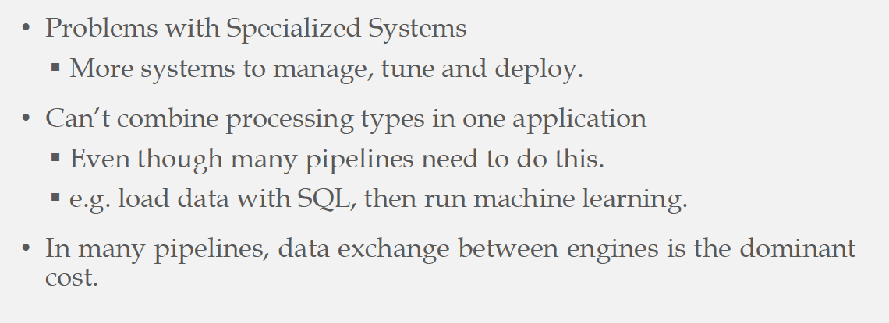

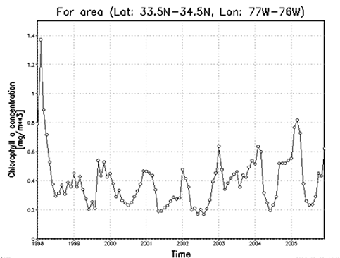
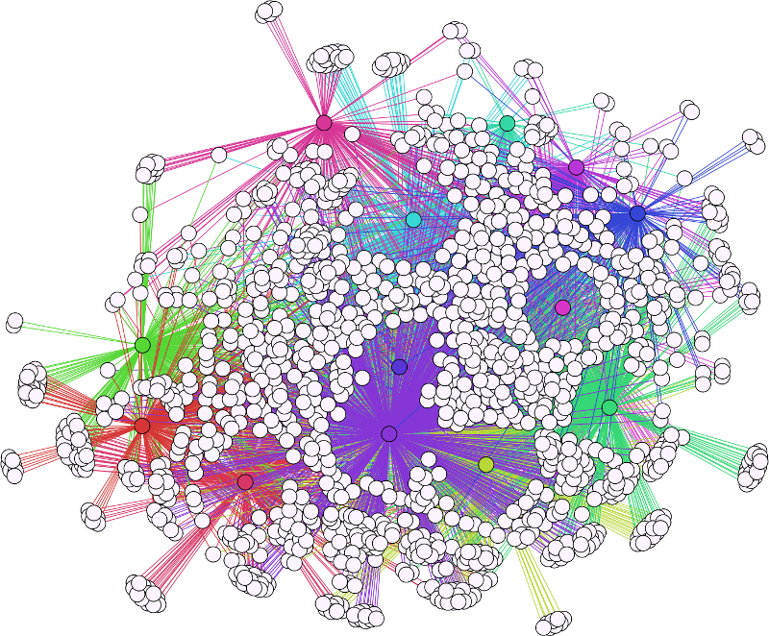
Specialized Systems: Downside
One application may need them all

Slide 5
Vision: Generic Efficient Infrastructure

Slide 6
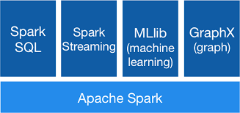
Vision: Generic Efficient Infrastructure

Slide 7
Motivation Workloads
Complex multi-pass algorithms
Interactive ad-hoc queries
Real-time steam processing
All need efficient data sharing and transfer

Slide 8
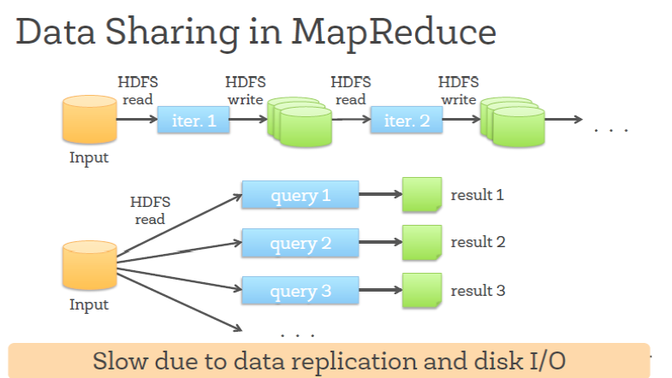
Motivation Workloads From This …

Slide 9
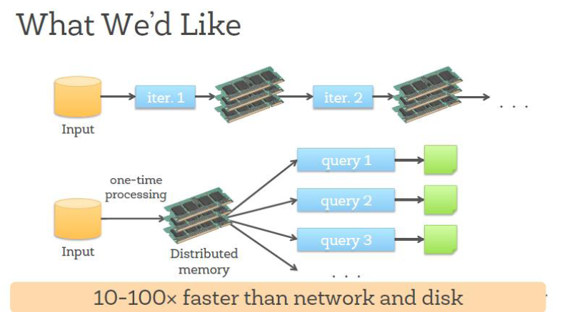
Motivation Workloads To This …

Slide 10
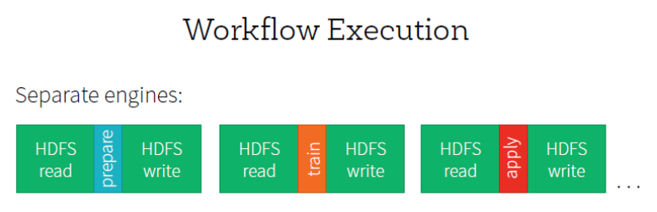
Motivation Workloads From This …

Slide 11

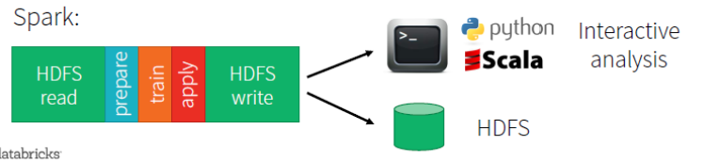
Motivation Workloads To This …

Slide 12
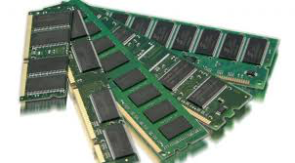
Motivation From Hardware Side
RAM is getting much cheaper
Commodity machines with GBs of RAM
Large Distributed RAM in the cluster
A lot of processing, storage, and data transfer should use RAM

Slide 13
Motivation: Summary
Better support for real-time processing
Exploit RAM as mush as possible
Large-Scale Distribution
Do not reinvent the wheel

Slide 14
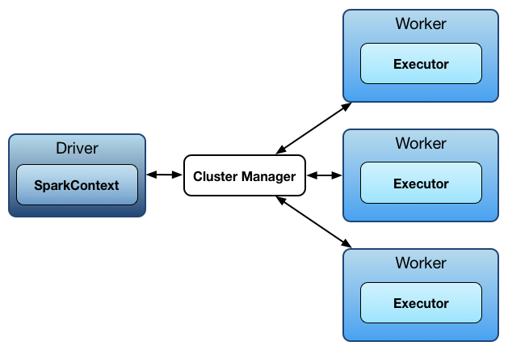
Spark Architecture
Master-Slave architecture

Slide 15
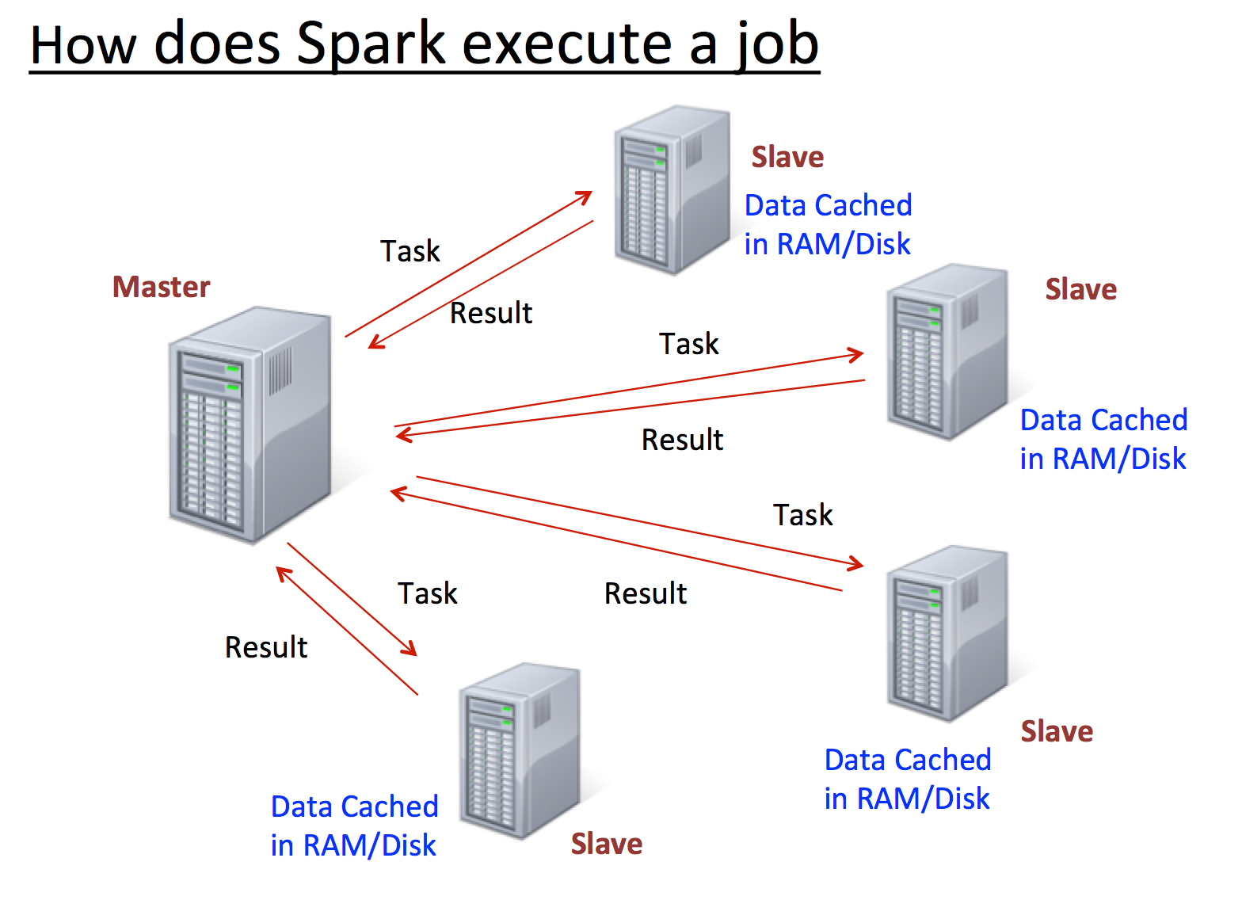
Spark Communication Model

Slide 16
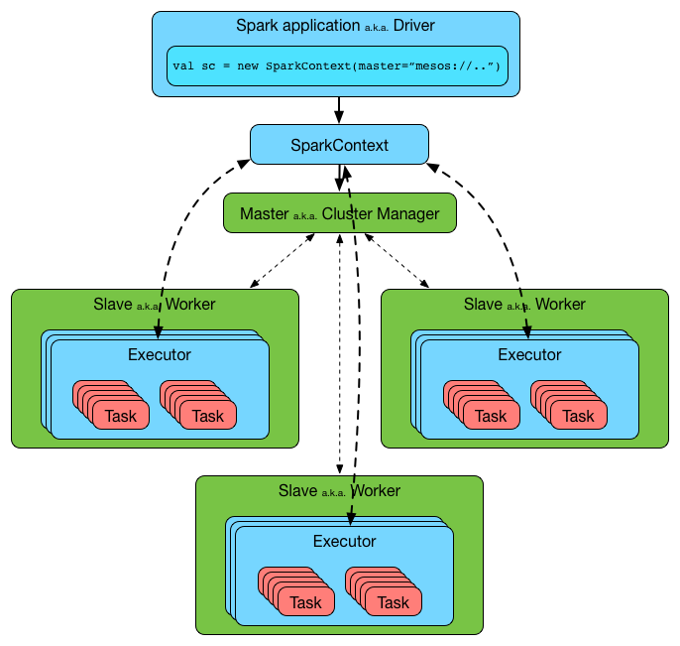
Example [Link]

Slide 17
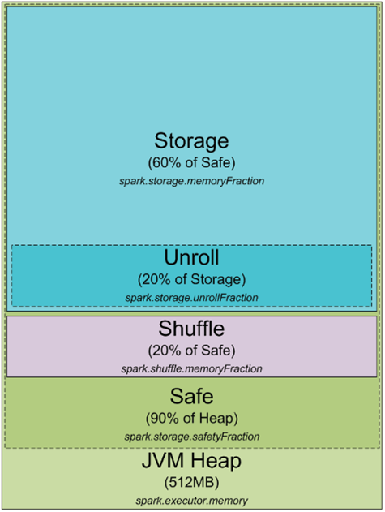
Spark Memory Management
Memory utilization is essential in Spark (Caching)
Spark process is a JVM process

Slide 18
Spark Programming Model
High-Level coding to build a workflow (Scala)
Code compiles to distributed parallel operations
Two Abstraction Units
RDDs: Resilient Distributed Datasets
Parallel Operations

Slide 19

General purpose programming language
Combines Object-Oriented and Functional programming
Compiles to Java bytecode
Runs on JVM

Slide 20
Spark RDDs

Slide 21
RDD: Concept
Resilient Distributed Datasets
Collection of objects (records) that act as one unit
Stored in main memory or disk
Parallel operations built on top of them
Have fault tolerance without replication (lineage)

Slide 22

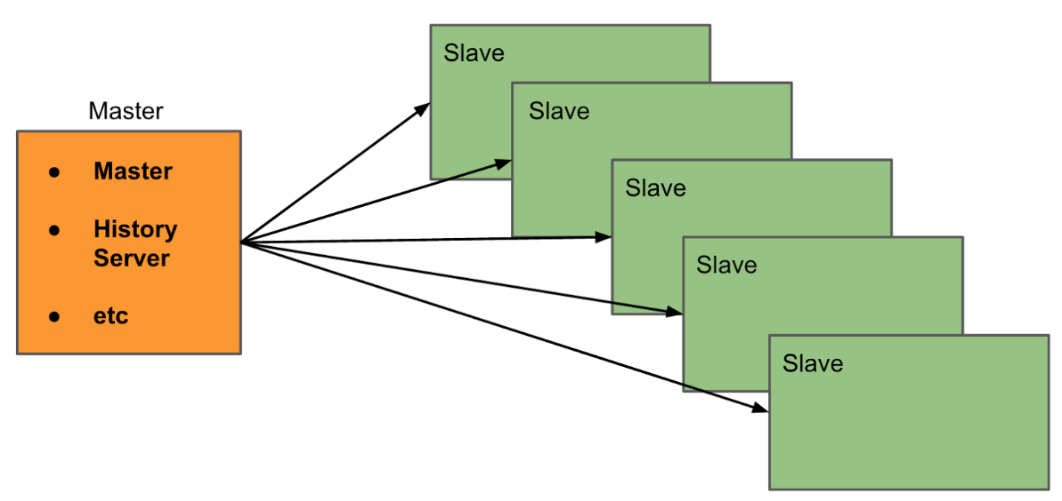
RDD: Concept
RDD is read-only
Distributed either in main memory or disk (automatically decided)

Slide 23
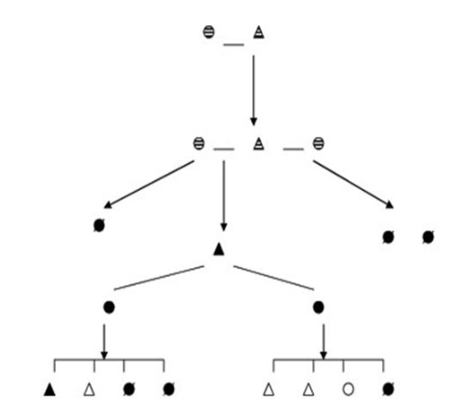
RDD: Fault Tolerance
Do not have to be replicated. But maintain the lineage (provenance) on how to re-create them starting from a data in reliable storage
Stored on disk
Lineage of this RDD

Slide 24
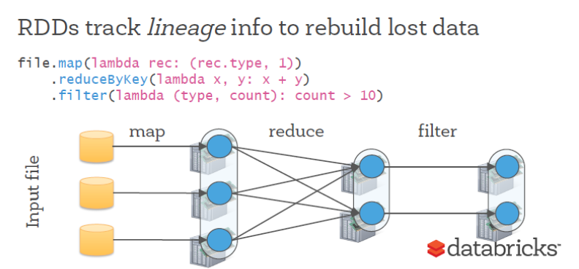
RDD: Fault Tolerance

Slide 25
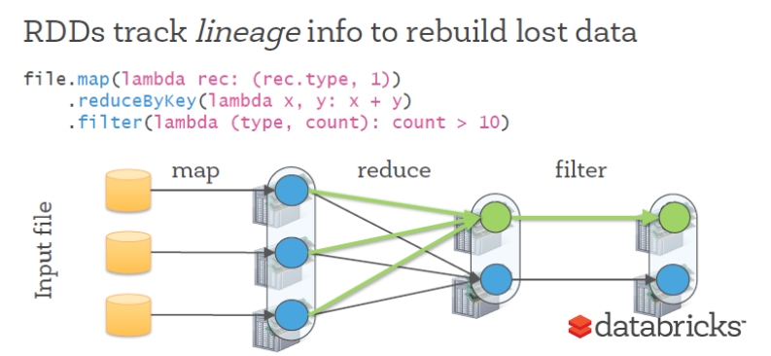
RDD: Fault Tolerance

Slide 26
RDD: User Control
Persistence and Partitioning Strategies
Indicate which RDDs they will reuse and choose a storage strategy for them (e.g., in-memory storage)
Ask that an RDD be partitioned across machines this is useful for placement optimizations.

Slide 27
RDD: Advantage
MapReduce access the computational power of the cluster, but not distributed memory
Time consuming and slow
RDDs allow in-memory storage and transfer of data

Slide 28
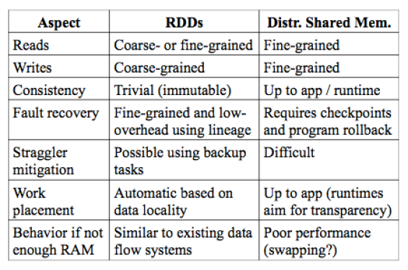
RDD vs. Traditional Shared Memory

Slide 29
Creating RDDs
Loading from external dataset (file)
Creating from another RDD (transformation)
Parallelizing a centralized collection

Slide 30
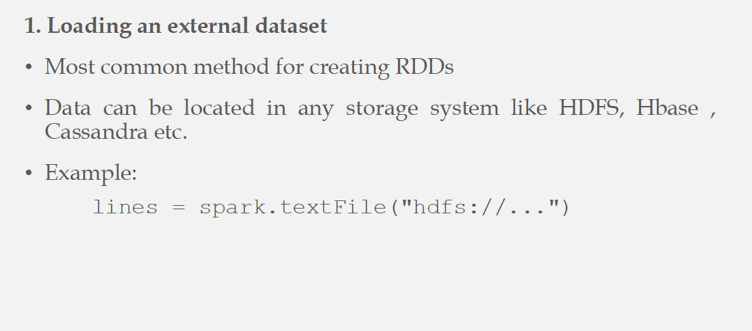
Creating RDDs
Support for HDFS, HBase, Amazon S3, …
RDD: #partitions = #of HDFS blocks

Slide 31
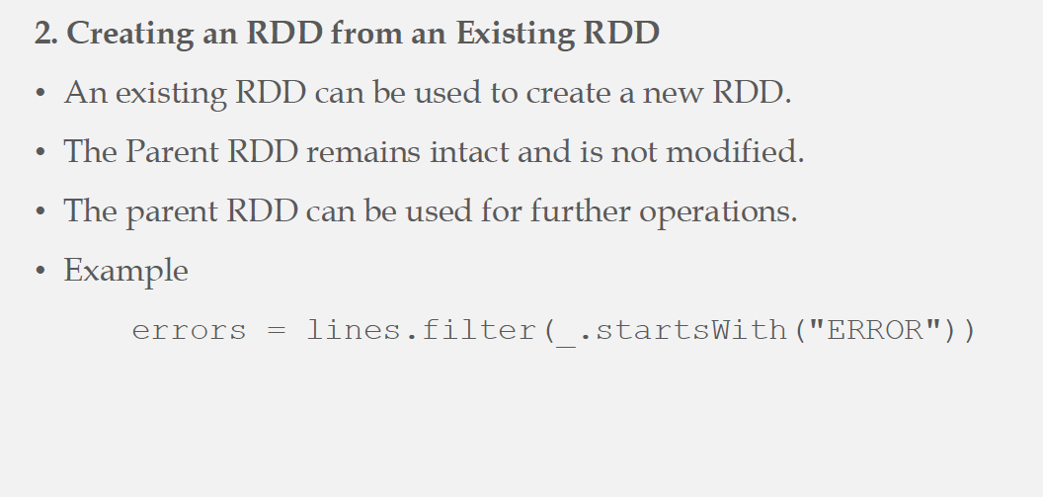
Creating RDDs
New RDD

Slide 32
Creating RDDs
3. Parallelizing centralized collection
val data = Array(1, 2, 3, 4, 5, 100, 8, 7, ….)
val distData = sc.parallelize(data)
val data = Array(1, 2, 3, 4, 5, 100, 8, 7, ….)
val distData = sc.parallelize(data, 10)
Create 10 partitions

Slide 33
Operations on RDDs
Create new RDD
Return value to caller
No execution is triggered for these Ops.
Execution is triggered for these Ops.
Transformation Ops. & Action Ops.
Similar to map-side of Hadoop
Similar to reduce-side of Hadoop

Slide 34
Transformation Ops
Operate on one RDD and generate a new RDD
Lazy evaluation
The input RDD is left intact
Examples: map, filter, join

Slide 35
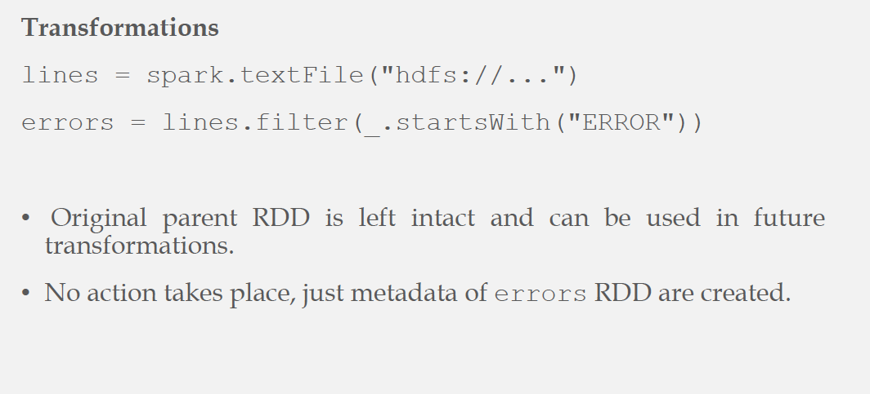
Transformation Ops: Example I

Slide 36
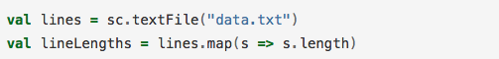

Transformation Ops: Example II
Up to Spark to keep it in memory OR re-compute when needed
Ask Spark to keep this RDD in memory

Slide 37
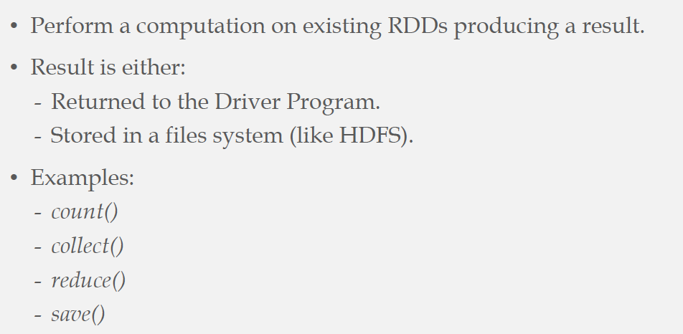
Action Ops

Slide 38
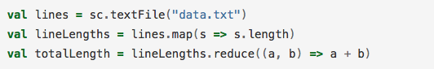
Action Ops: Example I

Slide 39
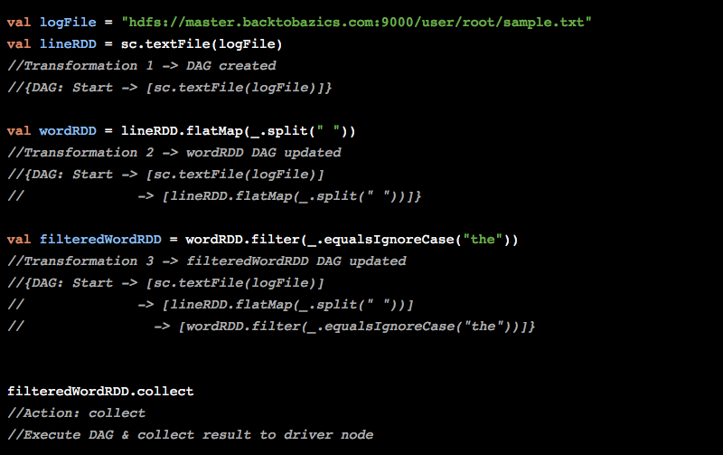
Action Ops: Example II [Link]

Slide 40
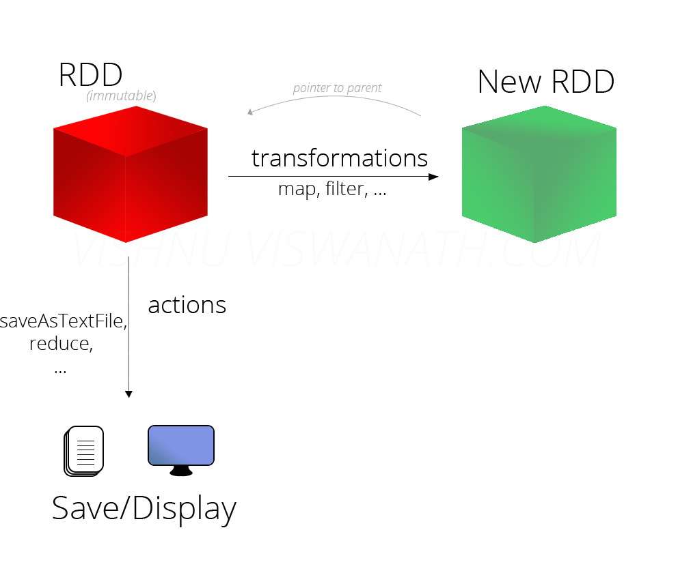
Transformations vs. Actions

Slide 41
Lazy Evaluation
Transformation ops on RDDs follow lazy evaluation
Results are not physically computed right away
Metadata regarding the transformations is recorded
Transformations are implemented only when an action is invoked

Slide 42
Example
lines = spark.textFile("hdfs://...")
errors = lines.filter(_.startsWith("ERROR"))
errors.count()
Execution is triggered here

Slide 43
RDD Fault Tolerance
In-memory RDDs are not replicated
RAM is still limited in size (Scarce Resource)
Lineage Graph
Directed Acyclic Graph (DAG)
Maintain dependencies between RDDs
Go back to the closest disk-based RDD

Slide 44
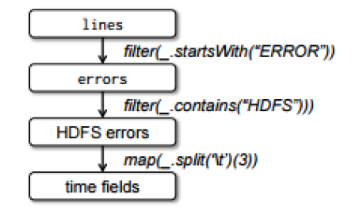
Lineage Graph
Not storing the data, but instead how it is generated (the processing steps)

Slide 45
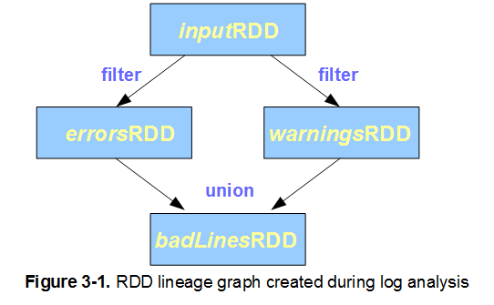
Lineage Graph

Slide 46
Representation of RDDs
Each RDD is divided into:
Multiple partitions
Dependencies on parent RDD(s)
Two types of Dependencies
Narrow
Wide

Slide 47
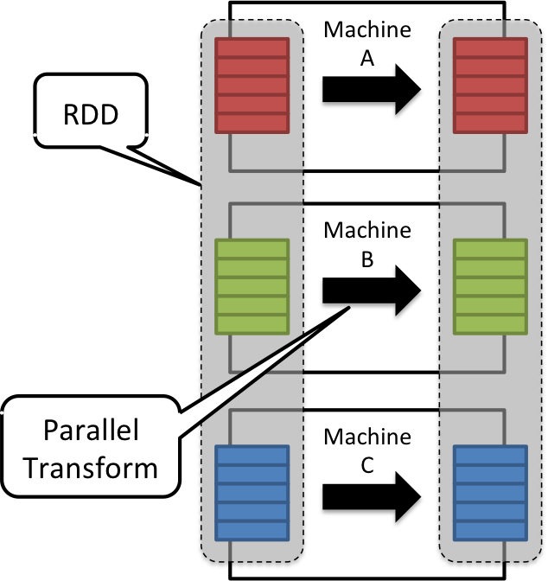
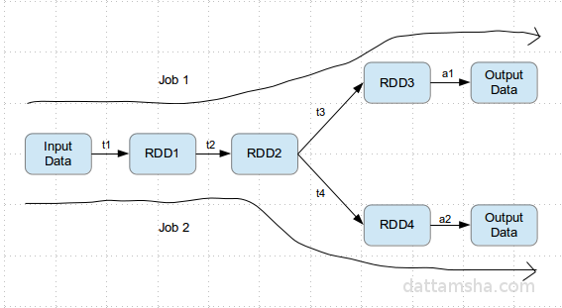
Representation of RDDs

Slide 48
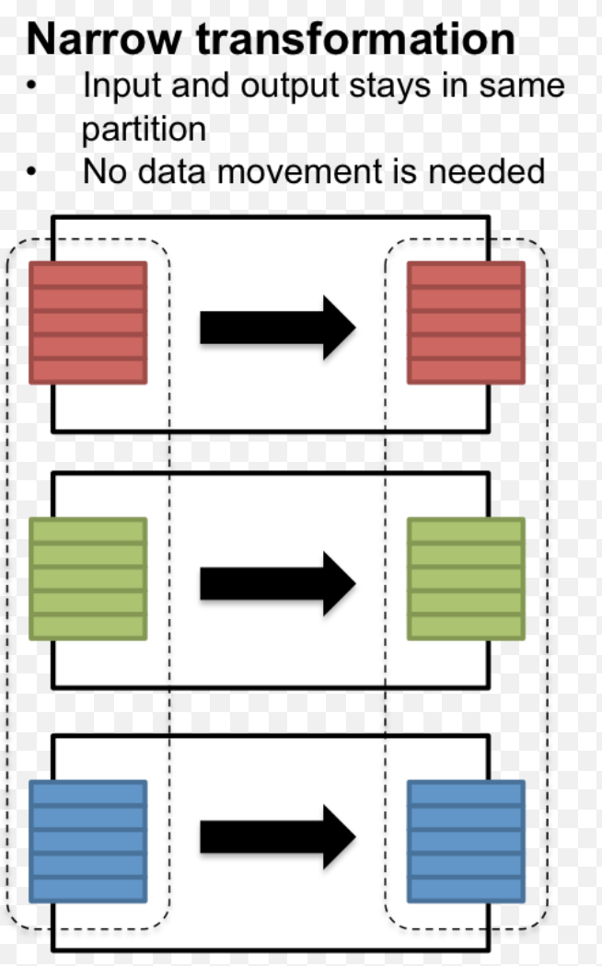
Narrow Dependency
1-1 relationship between child-parent partitions
Example Ops: Filter & Map
Relatively cheap process

Slide 49
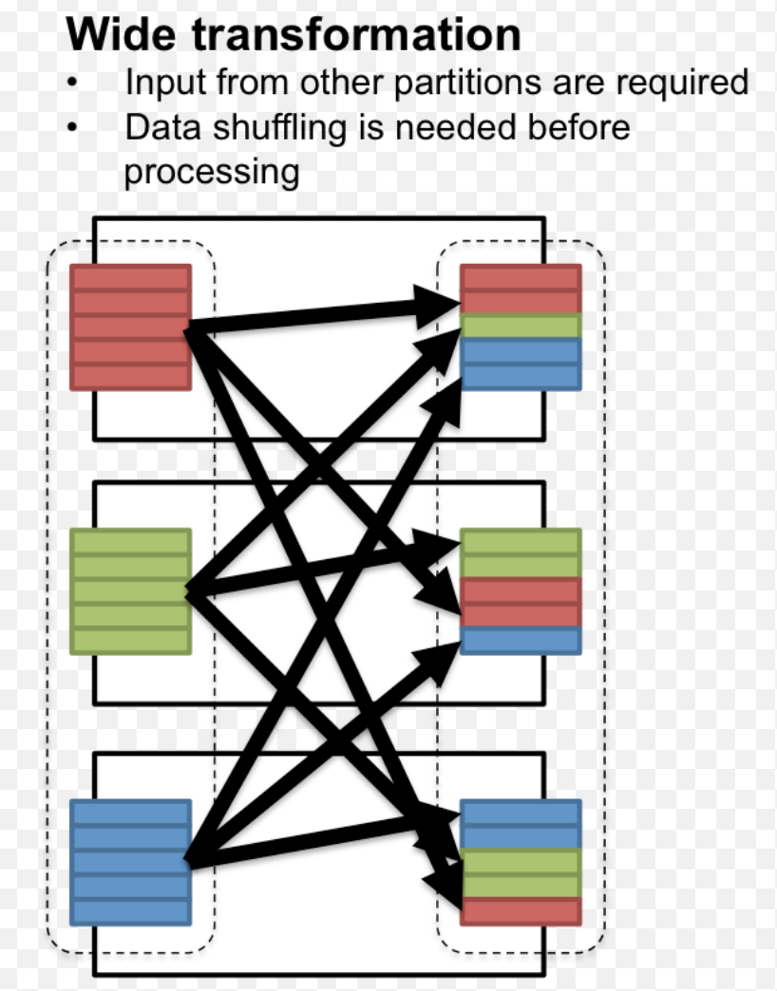
Wide Dependency
M-1 or M-M relationship between child-parent partitions
Example Ops: Join & Grouping
More expensive

Slide 50
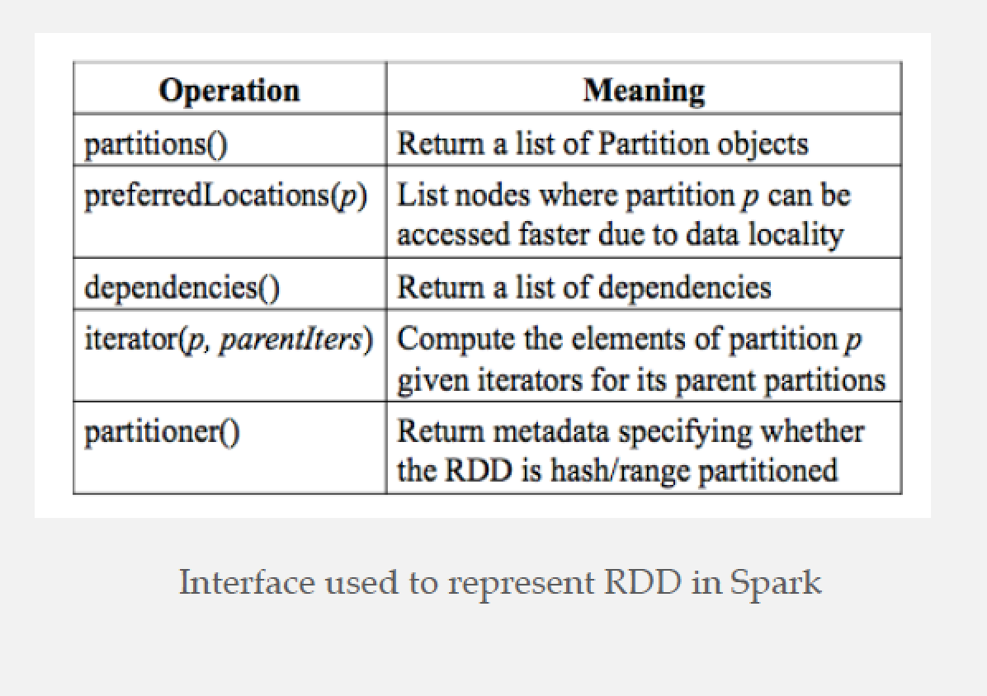
Interfaces on RDDs

Slide 51
Scheduling & Memory Management

Slide 52
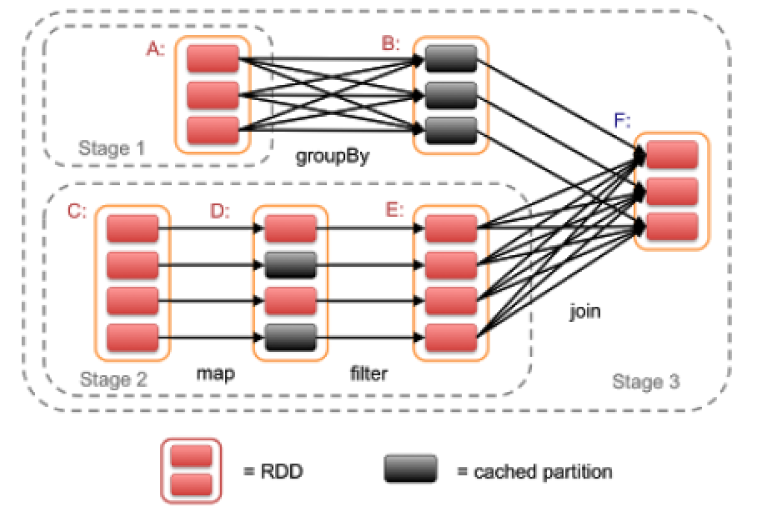
Scheduling
Execution is triggered when an “Action” op is invoked
Scheduler checks the lineage graph to execute

Slide 53
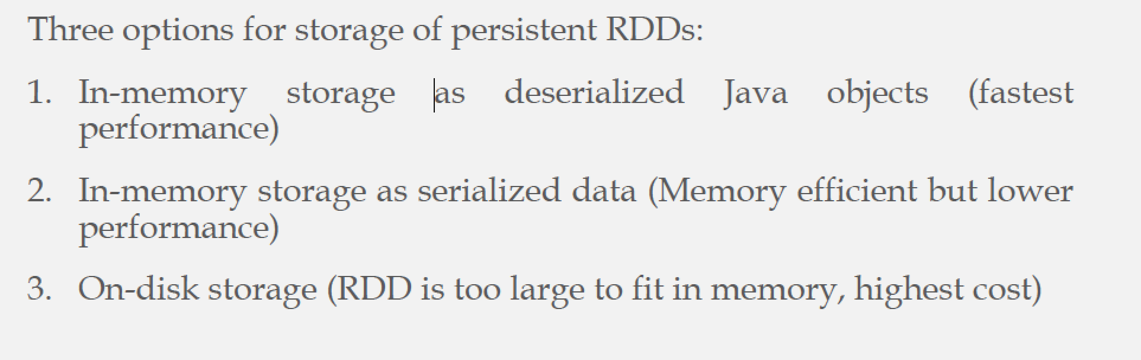
Spark Memory Management
Memory utilization is essential in Spark (Caching)

Slide 54
Spark Memory Management
RDDs are cached here
Spark process is a JVM process
Default memory is 512MBs
Parameters to control the usage of memory segments
Deserialization
Before data
transfer

Slide 55
Replacement Policy
LRU eviction policy at the level of RDD partitions is used
When a new RDD partition is created
If there is space in memory ➔ Cache it
If not ➔ evict one or more partitions from the LRU RDD
Use “persistence priority” to prevent eviction of important RDDs

Slide 56
RDD Recovery
In case of failure and losing an RDD partition
This partition is lost
X
X
This partition is lost

Slide 57
RDD Recovery
Recovery can be time consuming for RDDs with long lineage chains
Use of Checkpoint Mechanism to make some RDDs persistent
User defined, OR
System controlled, OR
More intelligent ways, e.g., workload driven

